Slide 1
CS 403/534: Distributed Systems
Python RabbitMQ
Şeyma Selcan Mağara
Sabanci University

Slide 2
Table of contents
Introduction
How it works?
ZMQ vs RabbitMQ
Examples of different patterns
Sender/Receiver
Pipeline (Workers)
1

Slide 3
Introduction
RabbitMQ is message queuing software or message broker or queue manager
Implementation of AMQP (Advanced Message Queuing Protocol)
Written in Erlang (general purpose, concurrent PL)

Slide 4
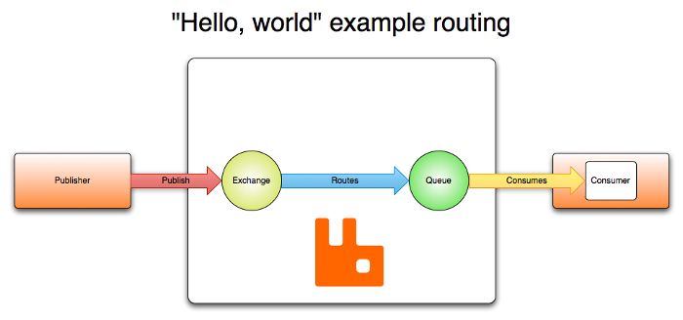
How it works?
Message broker works like a post office

Slide 5
How it works? - Components
Queue: Buffer to keep messages
Exchange: Responsible for routing the messages to different queues with the help of bindings and routing keys.
Binding: Link between queue and exchange
Routing key: A key that the exchange looks at to decide how to route the message to queues.

Slide 6
ZMQ vs RabbitMQ
ZMQ
Asynchronous
Faster
ZeroMQ doesn’t support persistence
No retention
RabbitMQ
Asynchronous
Slower compared to ZMQ
Support persistence
Acknowledgment based

Slide 7
Hello World - Sender
import pika
connection = pika.BlockingConnection(
pika.ConnectionParameters(host='localhost'))
channel = connection.channel()
channel.queue_declare(queue='hello')
channel.basic_publish(exchange='', routing_key='hello', body='Hello World!')
print(" [x] Sent 'Hello World!'")
connection.close()

Slide 8
Hello World - Receiver
import pika
connection = pika.BlockingConnection(
pika.ConnectionParameters(host='localhost'))
channel = connection.channel()
channel.queue_declare(queue='hello')
def callback(ch, method, properties, body):
print(" [x] Received %r" % body)
channel.basic_consume(
queue='hello', on_message_callback=callback, auto_ack=True)
print(' [*] Waiting for messages. To exit press CTRL+C')
channel.start_consuming()

Slide 9
Producer
channel.queue_declare(queue='task_queue', durable=True)
message = ' '.join(sys.argv[1:]) or "Hello World!"
channel.basic_publish(
exchange='',
routing_key='task_queue',
body=message,
properties=pika.BasicProperties(
delivery_mode=2, # make message persistent
))
print(" [x] Sent %r" % message)
connection.close()

Slide 10
Worker
channel.queue_declare(queue='task_queue', durable=True)
print(' [*] Waiting for messages. To exit press CTRL+C')
def callback(ch, method, properties, body):
print(" [x] Received %r" % body)
time.sleep(body.count(b'.'))
print(" [x] Done")
ch.basic_ack(delivery_tag=method.delivery_tag)
channel.basic_qos(prefetch_count=1)
channel.basic_consume(queue='task_queue', on_message_callback=callback)
channel.start_consuming()

